Slide 1


Lab 7
TA Presentations

Slide 2
Cryptography
Ben Ryjikov

Slide 3
Definition - Cryptography
Study of ways for people to communicate securely in the presence of a malicious eavesdropper
Alice and Bob want to communicate
Eve can spy on Alice and Bob’s connection
Eve can read messages sent between Alice and Bob
What can Alice and Bob do so that they can understand their messages but Eve cannot?

Slide 4
Definition - Cryptosystem
Protocol Alice and Bob can use to protect their messages from Eve
Describes how to encrypt and decrypt any message
“Payload” - what Alice and Bob send to each other
Alice and Bob send encrypted messages
Alice and Bob can decrypt the payloads they receive
Eve cannot

Slide 5
Multiplication Based Example
Alice and Bob agree on some key k
To send message m_{A} to Bob, Alice sends c = k * m_{A}
Bob receives c and calculates m_{A} = c / k
To send message m_{B} to Alice, Bob sends c = k * m_{B}
Alice receives c and calculates m_{B} = c / k

Slide 6
Alice
m_{A}
c / k = m_{B}
Eve
c = k * m_{A}
c = k * m_{B}
Bob
c / k = m_{A}
m_{B}

Slide 7
What is the Flaw?
Alice and Bob agree on some key k
To send message m_{A} to Bob, Alice sends c = k * m_{A}
Bob receives c and calculates m_{A} = c / k
To send message m_{B} to Alice, Bob sends c = k * m_{B}
Alice receives c and calculates m_{B} = c / k

Slide 8
What is the Flaw?
Alice and Bob agree on some key k
To send message m_{A} to Bob, Alice sends c = k * m_{A}
Bob receives c and calculates m_{A} = c / k
To send message m_{B} to Alice, Bob sends c = k * m_{B}
Alice receives c and calculates m_{B} = c / k
Alice and Bob need to communicate to decide on k
Need to send k to each other to confirm

Slide 9
Alice
k
k
m_{A}
c / k = m_{B}
Eve
k
k
c = k * m_{A}
c = k * m_{B}
Bob
k
k
c / k = m_{A}
m_{B}

Slide 10
What is the Flaw?
Eve knows what k is!
Eve can calculate c / k to decrypt any message Alice and Bob send to each other
Relying on Multiplication/Division is not enough - Alice and Bob need to use operations which Eve cannot perform

Slide 11
Definition (kinda) - Security by Obscurity
If no one knows how your system works, no one can break into it
Usually not enough
Alice and Bob can’t rely on Eve not knowing which Cryptosystem they are using
Alice and Bob need to agree on a Cryptosystem, and Eve can eavesdrop when they do that, so Eve will know their Cryptosystem
Alice and Bob need a Cryptosystem which Eve can’t break into even if Eve knows what it is

Slide 12
Public Key Cryptography
Alice and Bob choose Public Keys A and B
Everyone (including Eve) knows the values of A and B
Alice and Bob choose Private Keys a and b
Only Alice knows the value of a
Only Bob knows the value of b
To send a message m to Bob, use B to encrypt it
Bob then uses b to decrypt the payload
To send a message m to Alice, use A to encrypt it
Alice then uses a to decrypt the payload
Eve doesn’t know a or b so Eve cannot decrypt payloads!

Slide 13
Alice
m_{A}
D(a, c) = m_{B}
Eve
c = E(B, m_{A})
c = E(A, m_{B})
Bob
D(b, c) = m_{A}
m_{B}
A is Alice’s public Key
a is Alice’s private Key
B is Bob’s public Key
b is Bob’s private Key
E is Encryption Function
D is Decryption Function

Slide 14
Public Key Cryptography
Alice and Bob don’t need to send their public keys to each other - they can publish this info so that everyone can access it
Eve only gets to see encrypted payload
Eve needs Alice and Bob’s private keys in order to decrypt messages
Alice and Bob never need to send their private keys, so Eve doesn’t know them and Eve can’t decrypt messages
Eve can’t decrypt - Alice and Bob’s communication is safe

Slide 15
Cryptosystems and Number Theory
Public Key and Private Key need to be related somehow in order to use one for encryption and the other for decryption
Number Theory is very useful for figuring out these relationships
Diffie-Hellman Key Exchange uses exponents:
(gª)^{b} = (g^{b})ª for all g
gª and g^{b} are public keys, with a and b private keys
RSA uses the fact that it’s really hard to factor big numbers
With prime numbers m, n
Public Key is mn (Eve can’t factor it so Eve can’t use m,n to decrypt)

Slide 16
More on Cryptography
How can you expand Cryptosystems to work for more than 2 people?
What if Eve is more powerful
Does our Cryptosystem still work if Eve can block traffic and impersonate Bob, Alice?
Cryptography appears all over Cybersecurity
Safely storing Passwords
Network security - used to create secure networks
Web security - used to protect info being sent to the internet

Slide 17
Computer Graphics
Ashley Chung

Slide 18

What is Computer Graphics?
Creation, storage, rendering, and manipulation of models and images.
This can include modelling 3D objects, filtering, animation, and games…
Many applications in the modern world, including virtual/augmented reality!

Slide 19
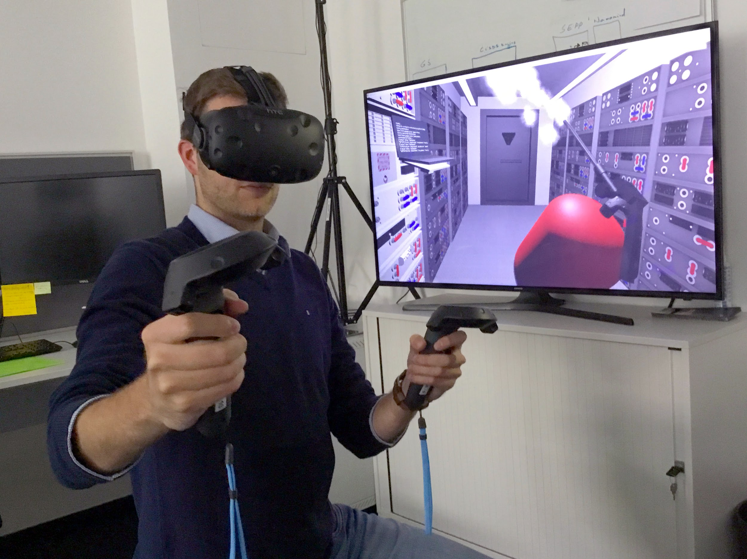

Interactive Computer Graphics
-The user controls content, structure, and appearance of objects via rapid visual feedback. (Drawing applications, rigging software, virtual reality, etc…)
-User’s input changes the actual visual information stored!

Slide 20
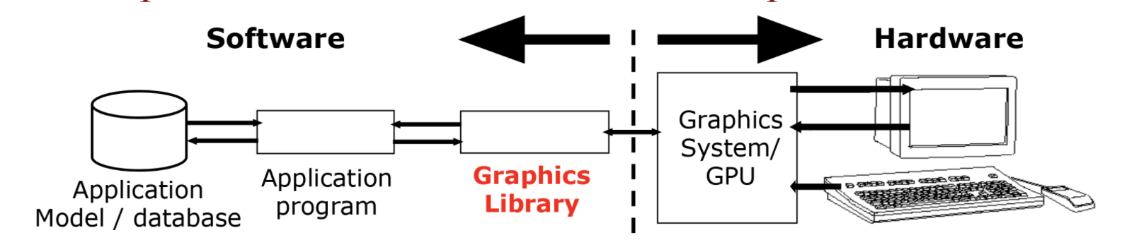
Conceptual Framework for Interactive Graphics
-There’s a CPU side and GPU side
-Usually, a programmer would use the Graphics Library as an intermediary to communicate between application and the Graphics System!
-Software (application) may contain lots of non-graphical data (like non-geometric object properties)

Slide 21

OpenGL
-A well-known industry standard graphics library for real-time 2D and 3D computer graphics
-Available on most platforms
-Implemented in C, C++, and many other programming languages

Slide 22
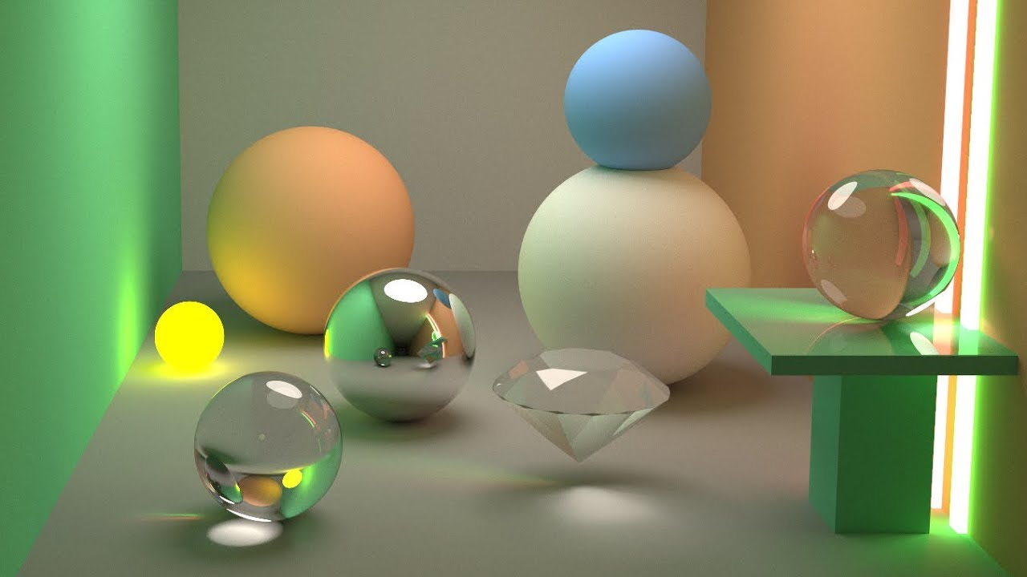

Applications
-Interactive 2D and 3D games
-Virtual reality, augmented reality
-Computer vision
-Creating painting programs like ProCreate, Illustrator, Clip Studio
-Creating 2D, 3D game engines
-Real-time graphical applications
-Mostly, graphics deals with the problem of how to represent and model the real world

Slide 23
Related Courses at Brown
CSCI 1230: Introduction to Computer Graphics
CSCI 1250: Introduction to Computer Animation
CSCI 1430: Computer Vision
CSCI 1950U: Topics in 3D Game Engine Development
CSCI 2240: Interactive Computer Graphics
CSCI 1950N: 2D Game Engines

